Slide 1
Unlocking Growth Opportunities:
Analysis of Sales Data 2011-2014
January 2015
RetailXpress

Slide 2

Introduction and the questions that led us here
RetailXpress
*CUSTOMERS, *PRODUCTS, *REACH
Questions:
Who are our customers and what are their spending habits and behaviours?
Should we target high-risk, high-value customers to improve satisfaction and reduce churn?
Which product categories should we continue to sell and which should we discontinue?
Which countries should we target for establishing new distribution hubs? What are the effects on profit margins?

Slide 3
Our journey through the data
RetailXpress
The following presentation looks at customer and sales data for orders placed between 01/01/2011 and 31/12/2014. As this data is more than 10 years old, the report has been produced as if the data was analysed on the 01/01/2015. This was done to avoid data and insights appearing out-of-date.
The following steps were taken to analyse the data and extract meaningful insights:
The dataset was cleaned and manipulated using Google OpenRefine. Any errors such as spelling errors, duplicates and outliers were amended.
The data was then imported into PowerBI and additional columns and measures were added where necessary, to allow for the appropriate analysis and insight generation.
Charts and visualisations were created within PowerBI and a standalone report was also created.

Slide 4
An overview of RFM analysis
RetailXpress
R
F
M
Recency - How recently was the last purchased made?
Frequency - How many orders were placed in a given time period?
Monetary - How much money was spent in a given time period?
Notes:
RFM analysis is a technique used to segment customers based on their purchasing behaviour, in order to gain a better understanding of customer behaviour and value. The goal of this analysis is produce valuable insights that can be used to improve retention, sales and overall business performance.

Slide 5




Discovering our Customers: Who are they?
RetailXpress
795 unique customers
were acquired between 2011 and 2014
from
147 different countries
The average customer
Last purchased from us
26
days ago
Placed
32
orders in total
Spent
£17.9k
in total
And had an average customer satisfaction score of
4.07
out of 10

Slide 6
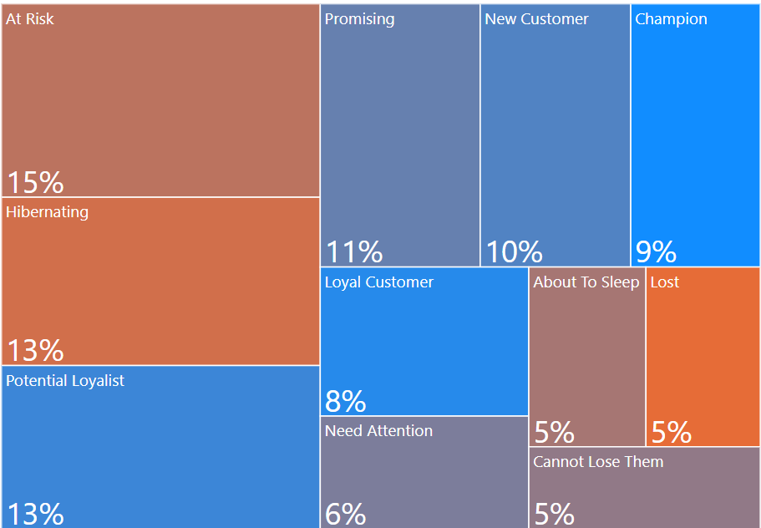
A large proportion of our Customers are showing signs of potential churn
RetailXpress
Proportion of customers by segment
‘At risk’ customers are those who have completed big, frequent purchases long ago.
They make up largest customer segment at 15%.
These customers are at risk of churn and so we need to bring them back.
Highest-potential segment to target
Our churn rate over the 4 year period was 5%.

Slide 7
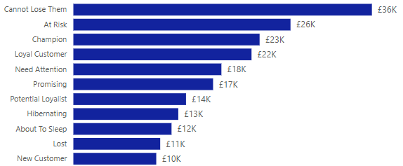
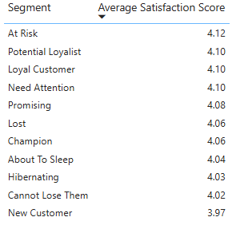
A large proportion of our Customers are showing signs of potential churn
RetailXpress
Average spend per customer by segment
Average satisfaction score per segment
At-risk customers are the second-highest spenders, with an average of £26k spent over 4 years.
They are a very important revenue stream for the company.
Satisfaction among all customer segments is low, signalling that there is room for improvement across the board.

Slide 8
Turning the tide: Our plan to delight and retain
RetailXpress
Invest Targeted strategy
Who? High-risk, high-value customers
Target ‘At-risk’ customers by sending them personalised emails with special offers
Share resources that they will find valuable to boost engagement and increase the chances of them placing an order with us

Slide 9
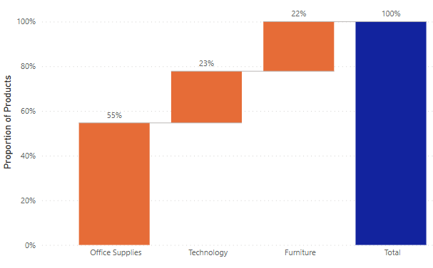
Our Product portfolio: A treasure trove
RetailXpress
We offer
3786 unique products
from
17 different sub-categories
across
Technology
Furniture
Office Supplies
Proportion of products by type
Office supplies make up the majority of products, representing 55%, compared to 23% for Technology and 22% for Furniture

Slide 10
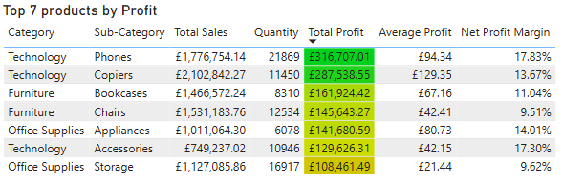
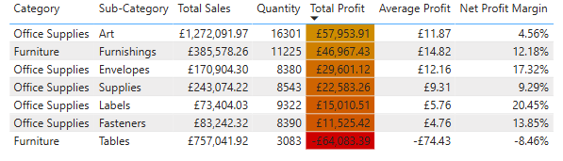
Hidden gems and silent losers: Unveiling Product performance
RetailXpress
Top 7 products by total profit
Phones, Copiers and Bookcases are the top performers
Bottom 7 products by total profit
Office supply products are among the lowest in terms of total profit, but some have an impressive net profit margin.
Tables are the worst performing, resulting in a loss.

Slide 11
The winning formula: Our strategy for Product success
RetailXpress
Easy win Technology
Has potential Office Supplies
Axe Tables
Prioritize and expand our Technology category, particularly our Phones and Copiers, as these are driving the most profit.
Products with negative profit margins, such as Tables, should be considered for discontinuation.
Office supplies with a low total profit and high net profit margin should be reviewed, as an improved marketing strategy could boost sales.

Slide 12
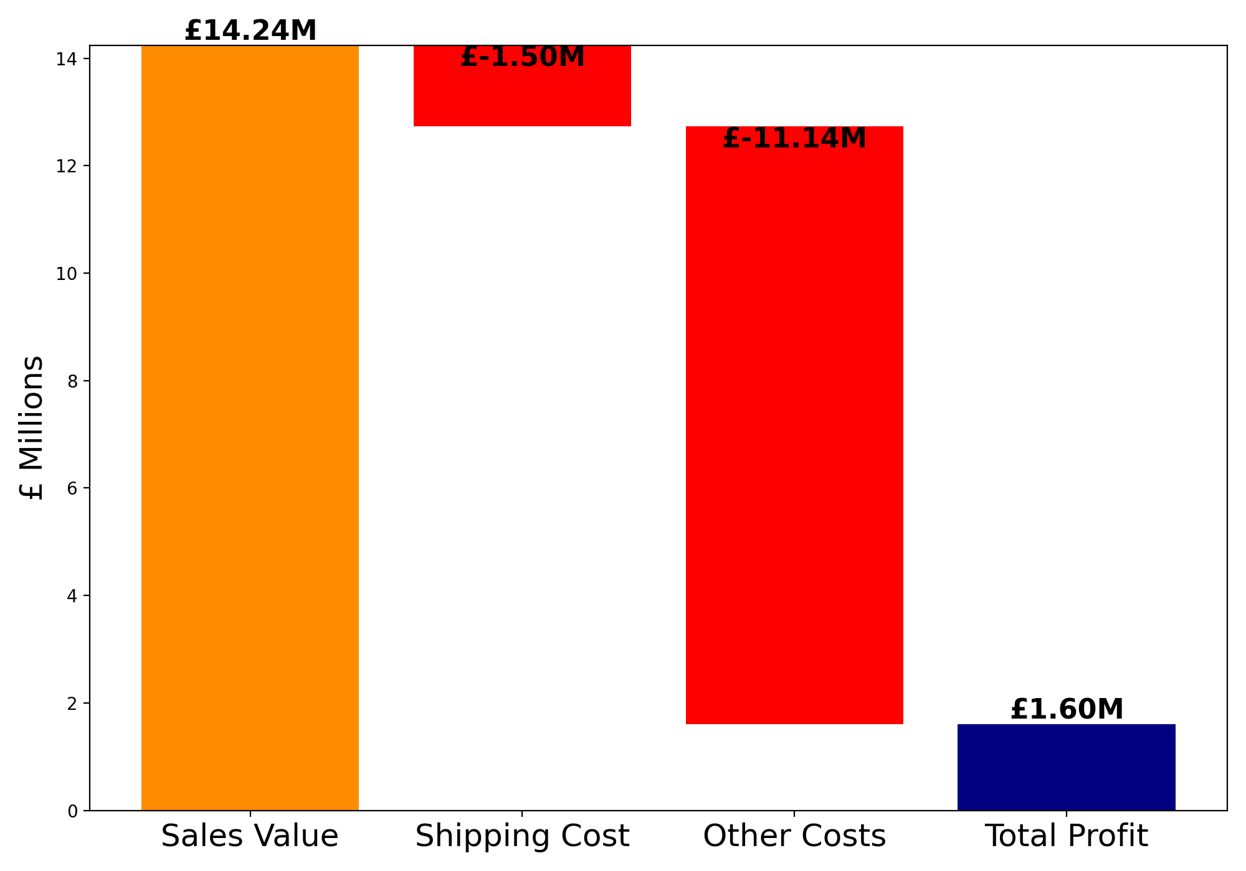
Our Reach: The shipping challenge
RetailXpress
Between 2011 and 2014, our orders were shipped to
147 different countries
across
6 continents
Breakdown of revenue and costs
Shipping costs came to a total of £1.50 million across all orders.
10.53% was the average shipping cost as a proportion of the sale value.
Net profit over 4 years came to £1.60 million.

Slide 13
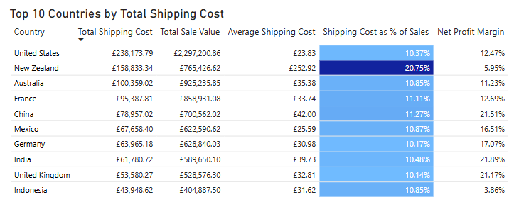
Unlocking profitability: The key to strategic distribution
RetailXpress
Top 10 countries ranked by total shipping cost
High shipping costs in certain countries lead to reduced profitability.
New Zealand stands out, with the highest shipping cost as % of sales, at 20.75%
This results in a low profitability for New Zealand, at just 5.95%.

Slide 14
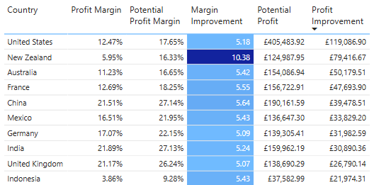
Unlocking profitability: The key to strategic distribution
RetailXpress
Potential profit margins if shipping costs were to decrease by 50%
Creating new distribution hubs could bring down shipping costs.
New Zealand would see the greatest benefit in terms of profit margin, with a potential to go up by 10.38 percentage points.

Slide 15
Hubs of opportunity: Our blueprint for expansion
RetailXpress
Establishing a new distribution hub in New Zealand would offer the highest returns, and could also boost profits from the Australian market.
US and Asia Hubs could also be considered, as these are high value markets. Additional distribution hubs could boost profit margins by over 5 percentage points, leading to a significant boost in profits.

Slide 16
The road ahead: The vision for RetailXpress
RetailXpress
Implementing a purpose driven strategy will ensure that we deliver sustainable growth across the business.
Short Term
Medium to Long Term
Invest in a targeted strategy for the high-value, high-risk customers to reduce churn and improve engagement.
Capitalize on our strength in Technology, and discontinue Furniture products that are leading to losses.
Establish a new distribution hub in New Zealand to improve cost efficiency and boost profit margins in the region.
Invest in other high-risk, but lower-value segments, such as ‘Hibernating’ by offering relevant products and special discounts to create brand value again.
Optimize our Office Supply portfolio, and review the marketing strategy for products with high profit margins, but low overall profits.
Create new distribution hubs in the US and China/Asia, to improve cost efficiency and boost profits in some of our largest markets.

Slide 17
Thank you for listening
Questions
RetailXpress

Slide 18
Looking into the future
RetailXpress
These are some of the steps that we can take next to further refine our growth strategy:
Repeat this analysis and review customer, product and shipping performance every year to measure progress and establish whether we are on track to achieve our goals.
Conduct a deep dive analysis on products. How does product performance vary by region/country? Are there specific brands of products driving the the success/failure in each product sub-category?
Deep dive analysis on shipping for our largest markets. How would profit margins in different US states be affected by establishing new distribution hubs? Identify specific states/cities with the highest potential for improvement.

